Slide 1
CUSTOMER RELATIONSHIP MANAGEMENT
CONCEPTS AND TECHNOLOGIES
Chapter 16
Service automation

Slide 2
About customer service 1
Customer service has been a necessary preoccupation of service organisations, because they have understood that customers are responsive to the quality of the service they experience.
The quality of customer service is just as important for agriculturalists, miners, and goods manufacturers. This is particularly so when there is product parity, and customers are unable to discern meaningful differences between alternative suppliers or brands.

Slide 3
About customer service 2
Customer service standards can be assessed by customers when a service is being performed, as well as after the service has been delivered.
  The service experience as perceived from the dentists chair during service delivery might be very different from the assessment a few days later.
Customer service can be experienced at any stage of the customer activity cycle: before, during, or after purchase.

Slide 4
Integrative quality
Integrative quality is determined by the way the various elements of the product and service delivery system work together.
  High integrative quality means that the processes, people and technology complement each other, working efficiently and effectively to deliver excellent customer service.
Customers who receive service from technology-enabled manufacturers or service providers, such as those with CRM systems in place, experience integrative quality.

Slide 5
Six attributes of companies renowned for excellent service 1
Customer service is pervasive.
  It is everyone’s responsibility; it is neither delegated nor relegated to a single department or function.
Their operations run smoothly with minimal product and service defect rates, allowing them to focus on pleasing customers.
They are always looking for ways to improve.

Slide 6
Six attributes of companies renowned for excellent service 2
Customer service lies at the heart of the value proposition.
  Customer service is the main selling point.
They build personal relationships with customers.
They employ the latest IT to
  allow their customers to interact with them more conveniently
  develop a profound understanding of what customers need and want
  track activities and processes that influence customer experience.

Slide 7
Service automation definition
Service automation is the application of computerised technologies to support service staff and management in the achievement of their work-related objectives.

Slide 8
Where is service automation deployed 1?
contact centres
  Contact centres are configured to communicate with customers across multiple channels including voice telephony, mail, email, SMS, instant messaging, web collaboration and fax.
call-centres
  Call centres are generally dedicated to voice telephony communications, whether through a public switched telephone network, cell-phone network, or VoIP.

Slide 9
Where is service automation deployed 2?
help-desk
  Help-desks are usually associated with IT environments where assistance is offered to IT users. SA applications such as case management, job management and service level management are used in this setting.
field service
  Field service is widespread in both B2C and B2B environments. Service automation applied to field service operations involves technologies such as job management, scheduling, mapping and spare parts management.

Slide 10
Key technological elements of SA 1
Infrastructure
  When service is delivered through a central call-centre or contact-centre, in a multi-channel environment, there needs to be tight integration between various communication systems, including telephony, email, and web.
Data
  Access to the right customer-related data, to enable the service agent to identify and fix the issue promptly is critical to the delivery of responsive customer service.

Slide 11
Key technological elements of SA 2
Devices
  Where service is delivered by a distributed work-force, smaller, lighter, devices such as laptops, Windows-enabled hand-held devices, and smart phones or cell phones such as Blackberries, tend to be employed; these are typically not found in call- and contact-centres. Synchronisation is also an issue for a distributed service team. Periodic synchronisation with the central CRM database enables service engineers and others to ensure that they are fully apprised of their daily scheduled appointments.
Software.

Slide 12
Benefits from service automation
Enhanced service effectiveness.
  Service requests can be completed more quickly to the customer’s satisfaction by ensuring that requests are handled or the first point of contact or routed to the right service engineer or customer service agent, who is able to draw on an up-to-date knowledge base to resolve the issue.
Greater service productivity.
  Call- and contact-centre management systems ensure that the optimal number of agents are scheduled and that their time is used productively. Field service applications ensure that workload is equitably and optimally distributed.
Improved customer experience.
  Agents have full visibility into the customer history and service request and can ensure that service delivery is appropriate to customer status or agreed service levels

Slide 13
Functionality offered by SA software
Activity management | Mapping and driving directions
Agent management | Outbound communications mgmt
Case assignment | Queuing and routing
Case management | Scripting
Contract management | Scheduling
Customer self-service | Service analytics
Email response management | Service level management
Escalation | Spare parts management
Inbound communications mgmt | Web collaboration
Invoicing | Workflow engineering
Job management

Slide 14
Activity management
Activity management enables service staff to review their workload, to-do list and priorities as directed by their manager or scheduler, and to report back on progress and issue resolution. Some applications allow activities to be updated in real-time by dispatchers and routed to the technician, so that work can be reprioritised. Alerts can be set so that appointments are not missed, or to notify agents and their managers that issues are unresolved or service levels are about to be, or have been, violated.

Slide 15
Agent management
Agent management is a high priority for call- and contact-centre managers. Managers want to employ the lowest head-count compatible with the desired level of customer service. Too few agents and customers will be dissatisfied with wait-times; too many agents and payroll costs will be unnecessarily high. Customers and managers both want issues to be resolved quickly by agents.
Technologies that contribute to this outcome include queuing, scripting, and knowledge management.

Slide 16
Case assignment
Case assignment applications ensure that each enquiry or issue gets routed to the right agent or technician for resolution.
Customer service agents might, for example, be organised according to language skills, and field service agent by product category

Slide 17
Case management
Case management covers the full cycle of activities involved from receiving initial notification of a matter of concern to a customer to its final resolution and the case file being closed.
  Case management is also known as incident management and issue management.
Cases, incidents or issues are initiated by the creation of a trouble ticket.
  Customers may be allowed to do this by web-form, or by emailing or calling a service or contact centre.

Slide 18
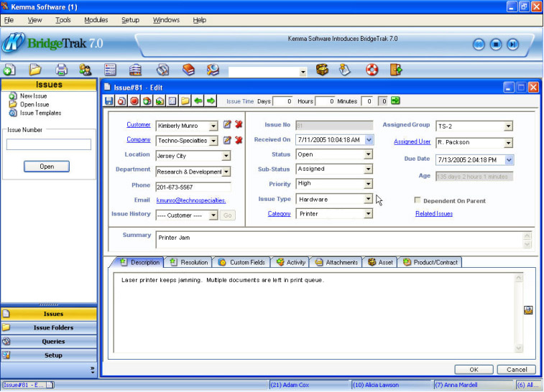
Trouble ticket screenshot

Slide 19
Contract management
Contract management functionality enables service engineers and managers to create, track, progress, accelerate, monitor and control service contracts with customers.
Many companies now sell extended service contracts to customers when warranty periods have expired.

Slide 20
Customer self-service
Customer self-service is an attractive option for companies because it transfers the responsibility and cost for service to the customer.
Customers who self-serve are much less likely to place demands on contact-centre, call-centre, help-desk or field service staff.
Customers are typically more competent at self-serving when transactions are involved (e.g. online banking or music downloads); however, they are less competent when problem-resolution is concerned.

Slide 21
Email response management systems
Email response management systems (ERMS) are not only useful for handling inbound emails but also for delivering outbound emails and SMS messages.
ERMS are designed up to manage the reception, interpretation, routing, response and storage of incoming email securely and effectively.

Slide 22
Escalation
Escalation ensures that issues get escalated according to internally determined rules. Higher levels of authority typically have greater discretion to resolve issues. For example, a front-line customer service agent might be required to escalate to higher levels of management issues that have a potentially high cost or reputational consequence.

Slide 23
Inbo8und communications management
Inbound communications management (ICM) applications allow companies to receive, route, queue and distribute incoming communications from any channel – voice telephony, email, fax, instant message, SMS, fax, web form – to agents in any location including contact centre, in the field or at home.
A unified queue, issue/content recognition, intelligent routing, and knowledge-base integration allow agents to deliver a consistent customer experience and to respond effectively to service requests whatever the communication channel.

Slide 24
Invoicing
Invoicing is a useful application for service technicians who are called to site to provide out-of-warranty service. Having completed the job to the customer’s satisfaction, and captured the customer’s signature electronically, the invoice can be raised on the spot, thereby accelerating cash flow.

Slide 25
Job management
Job management applications offer a range of functionality including cost estimation, quotation generation, creation of trouble tickets, job planning, travel time and distance calculation, job clustering (to reduce travel time), calendaring, scheduling, spare parts management, job progress tracking, invoicing, service level management, technician despatch, time management and product configuration.

Slide 26
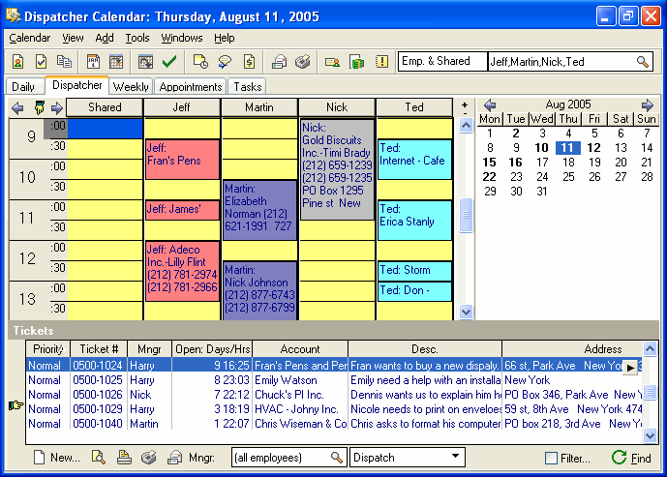
Job management screenshot

Slide 27
Mapping and driving directions
Solutions that provide mapping and driving directions are very useful for service engineers who need to visit customers’ homes or business premises. Taking into account the engineer’s point-of-origin, service locations, job priorities, service level agreements and other variables, mapping solutions can minimize travel times and distances to ensure that service tasks are performed optimally.

Slide 28
Outbound communications management
Outbound communications management software applications are used in a service environment to acknowledge service requests, make and confirm service appointments, advise on the progress of a service task, invoice for out-of-warranty service, and follow-up after service to ensure that the customer is satisfied

Slide 29
Queuing and routing
Queuing and routing applications allow issues to be routed to agents with particular expertise and positioned in that agent’s queue according to some criterion.
Routing is usually determined by case assignment rules and position in the queue is determined by customer value or some other metric.
The objective of queuing and routing is to ensure that every service issue is presented to the most appropriate agent for handling and resolution.

Slide 30
Scheduling
Scheduling involves planning and organising a service technician’s activity plan for a day, week or other period.
A technician’s schedule contains details on the customer, location, time, product and issue.
Some scheduling applications take into account a range of considerations to ensure that the right technician is sent to service the customer
  travel time and distance, technician availability, technician skills, customer access hours, service level agreement, availability of spare parts, and the technician’s hourly rates of pay.

Slide 31
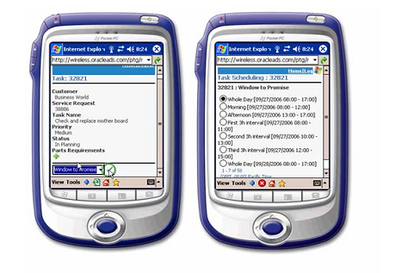
Task schedule delivered to a Pocket PC

Slide 32
Scripting
Scripting enables customer service agents to converse intelligently with customers to diagnose and resolve problems, even though they may be untrained as technicians. Scripts can be designed so that they flex dynamically according to customer response. Scripts also reduce agent training time.

Slide 33
Service analytics
Service analytics provide managers with information on how effectively and efficiently customer service generally, and individual agents or technicians specifically, are operating. Important metrics for managers of field service operations, for example, include technician utilization, parts inventory, travel time, first time fix rate (FTFR), mean time to resolve (MMTR), and job backlog.

Slide 34
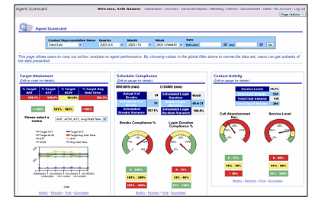
Contact centre telephony dashboard

Slide 35
Service level management
Service level management applications allow managers to control the level of service that is offered to customers, and technicians to deliver the level of service agreed.
Service levels can be agreed for a number of variables including availability (the percentage of time that the service is available over an agreed time period), usage (the number of service users that can be served simultaneously) and responsiveness (the speed with which a demand for service is fulfilled).

Slide 36
Spare parts management
Spare parts management is an important application for field technicians. They can see what parts they have with them on the road, check the inventory levels held by other technicians and at regional and central warehouses, order new parts, transfer parts from colleagues, manage excess and defective parts, and check on the progress of orders thereby ensuring that when they turn up at a job, they are properly equipped

Slide 37
Web collaboration
Web collaboration between customer and service agent is enabled by technologies that use instant messaging (web chat), or allow both parties to co-browse web-pages. This allows the agent to help the customer to resolve the issue in real time.
Customer service agents can collaborate with a number of customers simultaneously, or can prioritise based on customer value or some other metric.

Slide 38
Work-flow engineering
Work-flow engineering software is useful for designing service-related processes, such as problem diagnosis and issue escalation.
Work-flow for field service operations will define how service requests are validated, how service tickets are issued, how tickets are allocated, how problems will be diagnosed, how parts will be ordered, how problems will be fixed, how customers will be invoiced, and so on.

